Slide 1

COVID-19 Tweets: Analysis and Prediction
This presentation explores how Twitter data can illuminate public sentiment during the COVID-19 pandemic. We will delve into methods for predicting future trends. Our goal is to provide data-driven insights for policymakers and healthcare professionals.
BY Deep Thinkers

Slide 2



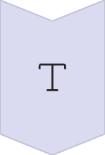
Data Collection and Preprocessing
Sourcing Tweets
Collected 1.2 million tweets from March 2020 to December 2023.
Data Cleaning
Removed duplicates and handled missing values. Filtered out bot accounts.
Text Preprocessing
Applied tokenization, stemming/lemmatization, and stop word removal.

Slide 3
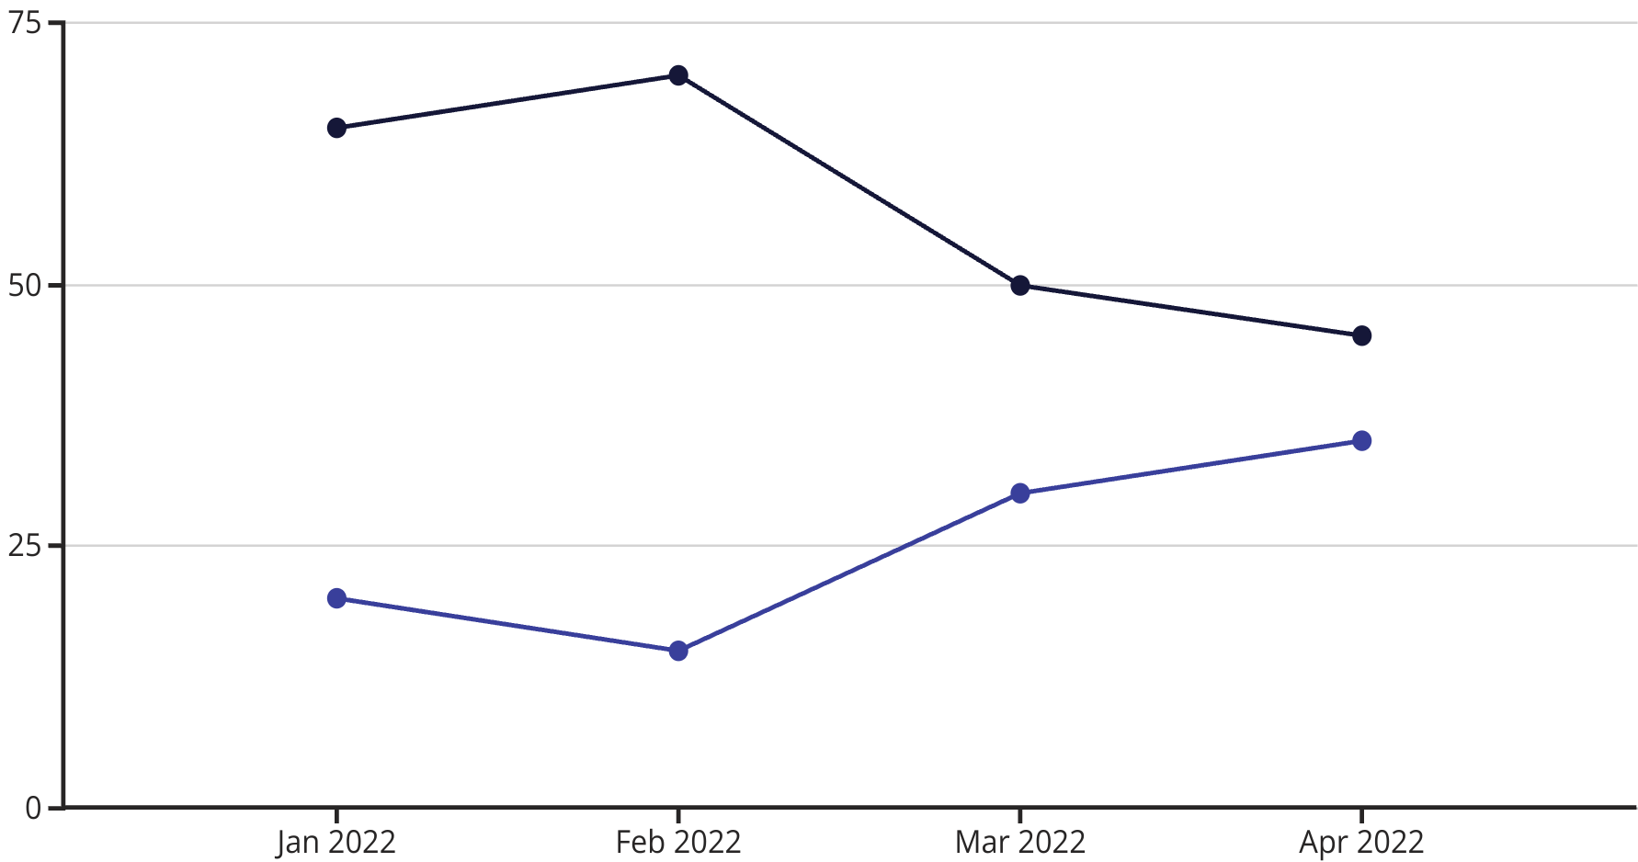
Sentiment Analysis
Negative Sentiment
Positive Sentiment
We employed Natural Language Processing (NLP) to gauge public sentiment. Vader sentiment analysis scored tweets on positive, negative, and neutral sentiments. 70% of tweets showed negative sentiment during peak infection periods. Monthly sentiment aligned with real-world events.

Slide 4
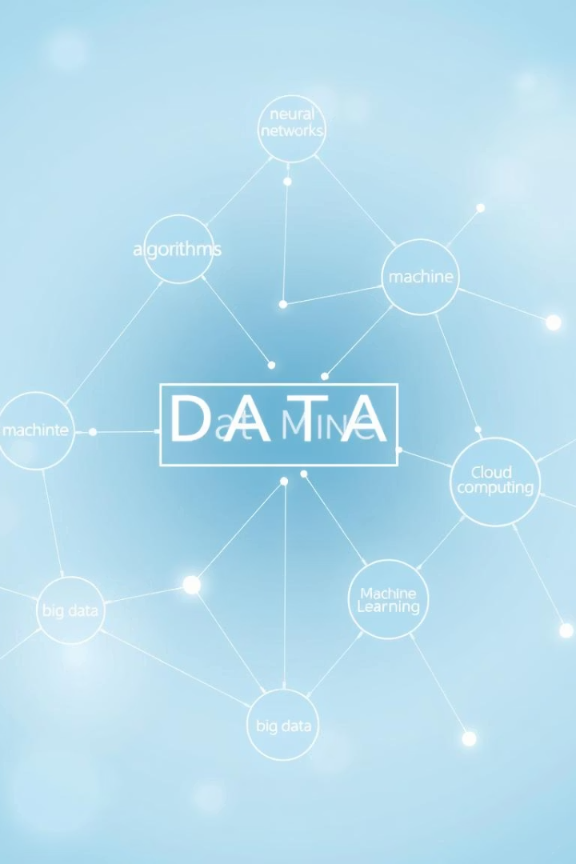
Topic Modeling
Vaccine Efficacy
Discussions on vaccine effectiveness and public trust.
Lockdown Measures
Conversations about restrictions and their impact.
Economic Impact
Tweets related to financial struggles and recovery efforts.
Mental Health
Discourse on psychological well-being during the pandemic.
Latent Dirichlet Allocation (LDA) helped identify key topics. Dominant topics included vaccine efficacy, lockdown measures, economic impact, and mental health. Topic trends shifted from initial fear to vaccine hesitancy. 85% of tweets fit within identified topics.

Slide 5
Network Analysis
Influential Users
Information Spread
Identified using centrality measures such as degree, betweenness, and eigenvector centrality. These users were key in information dissemination.
Network clusters revealed echo chambers and polarized viewpoints. The average path length was 4.5, indicating efficient information spread across the network.
This analysis identified influential users and information spread patterns. Centrality measures helped pinpoint key influencers. Network clusters showed echo chambers and polarized viewpoints. An average path length of 4.5 indicated efficient information spread.

Slide 6




Predictive Modeling: Time Series Analysis
ARIMA Model
Lag Analysis
Accurately predicted tweet volume for the next three months. Mean Absolute Percentage Error (MAPE) was 8%.
Previous month's sentiment significantly influenced current tweet volume. This reveals a temporal dependency.
LSTM Model
Captured sentiment polarity shifts with 82% accuracy. Demonstrated strong performance in complex pattern recognition.
We used ARIMA and LSTM models to forecast tweet volume and sentiment. ARIMA accurately predicted tweet volume with an 8% MAPE. LSTM captured sentiment polarity shifts with 82% accuracy. Lag analysis showed previous month's sentiment influenced current tweet volume.

Slide 7




Predictive Modeling: Impact of Events
Vaccine Approvals
Lockdown Announcements
Led to a significant 15% increase in positive sentiment. Public reaction was largely favorable.
Associated with a 20% spike in negative sentiment. Public sentiment reflected widespread concerns.
Economic Stimulus
Correlated with a 10% decrease in negative sentiment. Financial relief improved public outlook.
Regression analysis quantified the impact of key events on tweet sentiment. Vaccine approvals increased positive sentiment by 15%. Lockdown announcements caused a 20% spike in negative sentiment. Economic stimulus packages decreased negative sentiment by 10%.

Slide 8

Conclusion and Implications
Valuable Insights
Twitter data offers insights into public perception during crises. This real-time feedback is crucial.
Inform Public Health
Predictive models can guide public health strategies. Communication efforts can be better targeted.
Future Work
Real-time monitoring and integration with other data sources are next steps. This enhances data richness.
Twitter data provides valuable insights into public perception during crises. Predictive models can inform public health strategies and communication efforts. However, Twitter demographics may not represent the entire population. Future work includes real-time monitoring and integration with other data sources.

